Slide 1

INFOSYS SPRINGBOARD INTERNSHIP 2025
Project Name:- WasteZero: Smart Waste Pickup & Recycling Platform

Slide 2
INTERNS INVOLVED IN THE INTERNSHIP
Sri Abhigna
Debosmita Samanta
Dhivya Shreetha S
Bhavitha Vemuri
Chirag Dev
Feny Baria
Gayathri MH
Harsha P H
Mrittika Das
Pranay Jain
Shajitha S
Sravani Ponna
Dhyan J Prakash
GUIDED MENTOR :- RAMKUMAR SIR

Slide 3
Imagine a city where waste never piles up, recycling is effortless, and everyone plays a part in creating a cleaner future. Key features include:-
Seamless scheduling and pickup for all types of waste
Intelligent agent assignment and real-time notifications
Empowering communities to take action towards sustainability
INTRODUCTION TO WasteZero
"WasteZero: Innovating Urban Recycling”

Slide 4
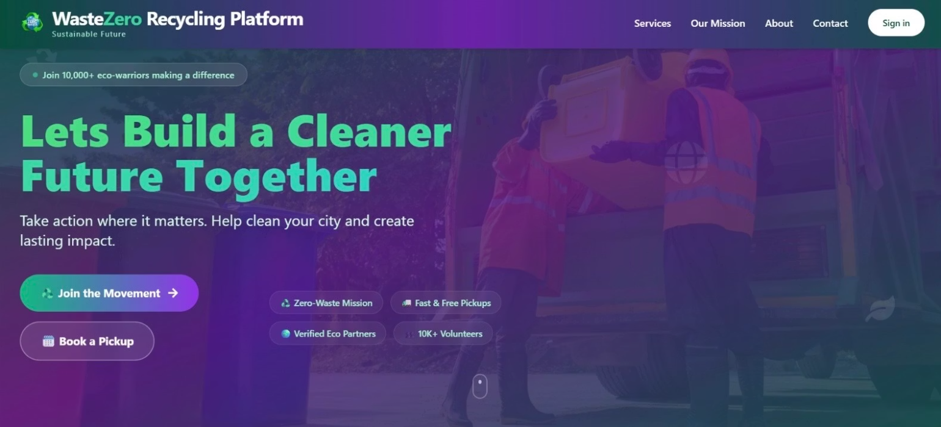
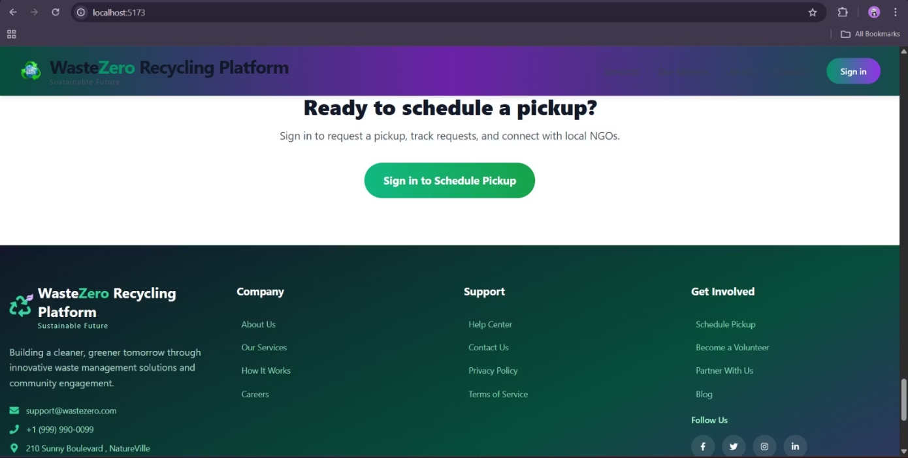
LANDING PAGE
Contains WasteZERO logo and navigation links to Home, Signup, Login, and Contact Us pages.
Home:- Returns to the landing page.
Signup:- Takes the user to the signup page to create a new account.
Login:- Takes the user to the login page to access their existing account.
Contact Us:- Provides information on how to reach the WasteZero team for support or inquiries.

Slide 5
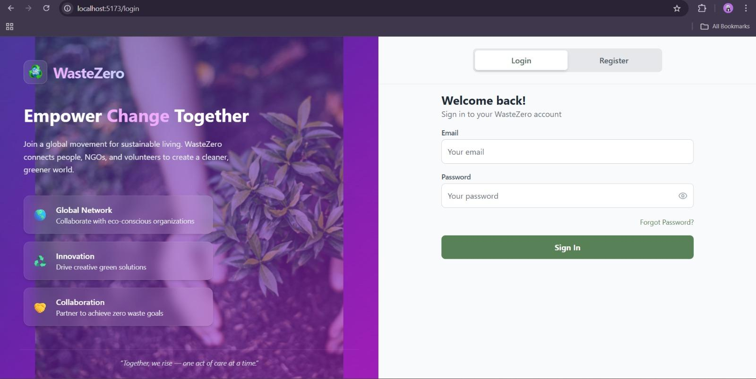
LOGIN PAGE
The login page includes fields for Email and Password.
User can directly redirect to Sign Up page
Including Password Recovery function

Slide 6
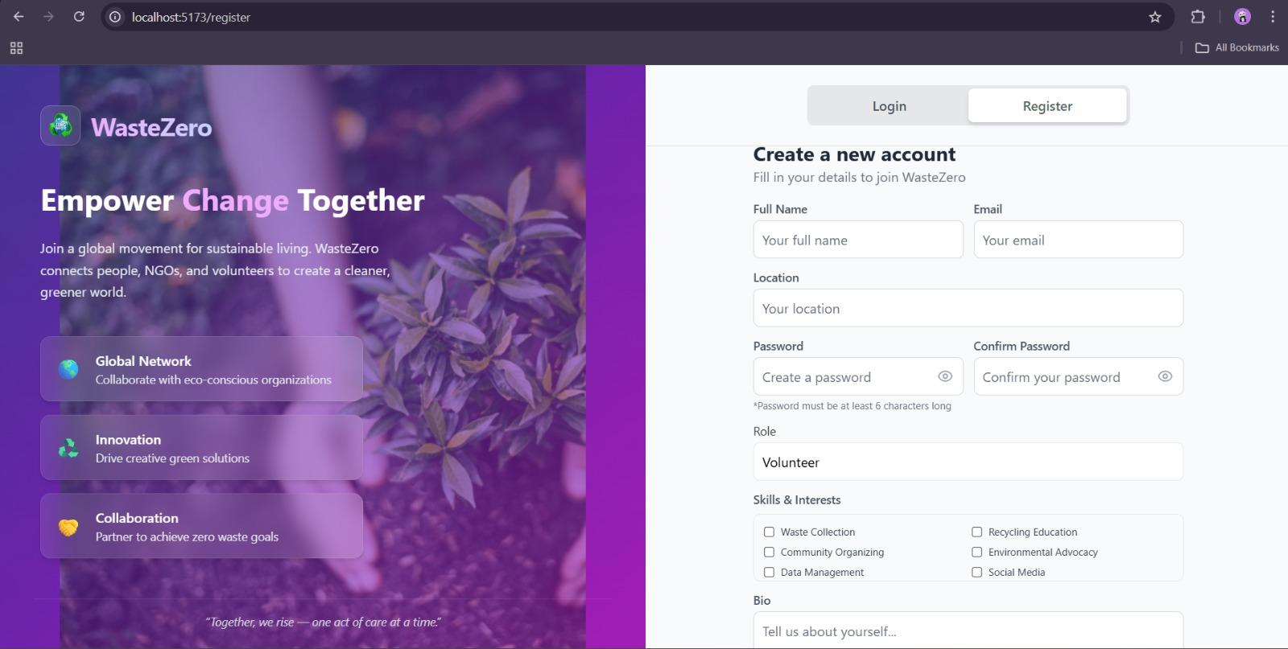
SIGN-UP PAGE
The signup page includes a form where users can enter their details
(name, email, password) to create an account.
User can redirect to Sign In page

Slide 7
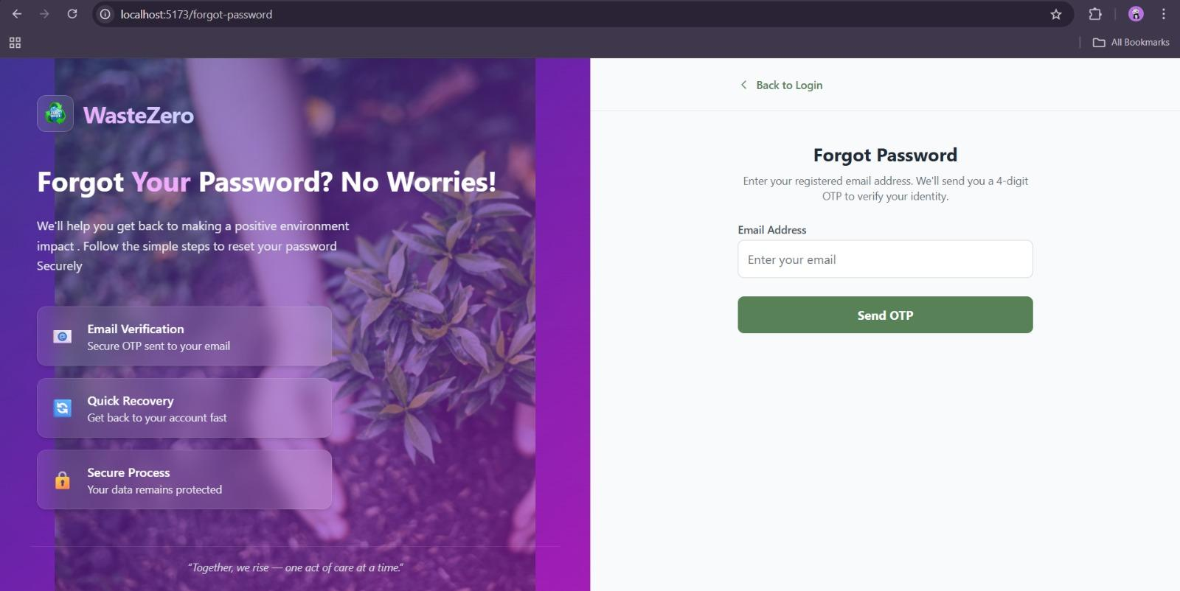
FORGOT PASSWORD PAGE
Helps to recover the forgotten Password
Uses a OTP verification
Contains a Email field

Slide 8
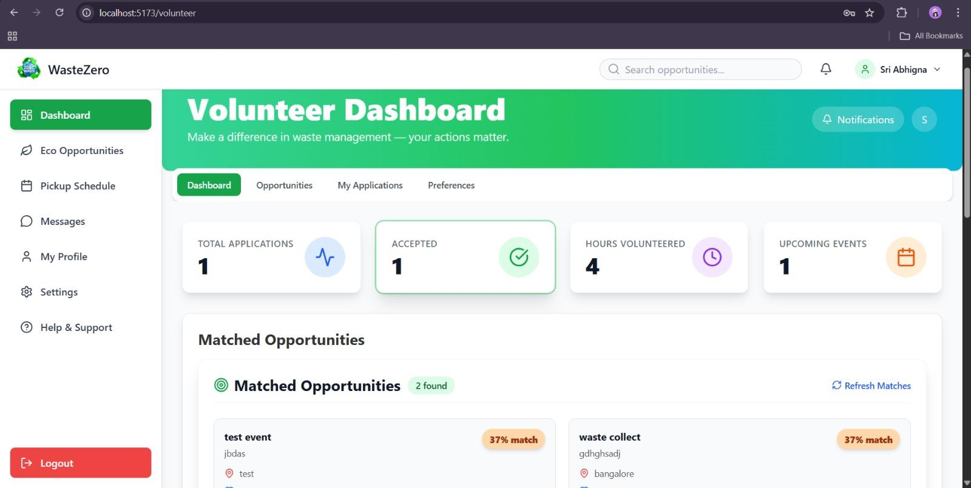
VOLUNTEER DASHBOARD
Display the daily activities
Uses the Charts
Time-Completion percentage Graph

Slide 9
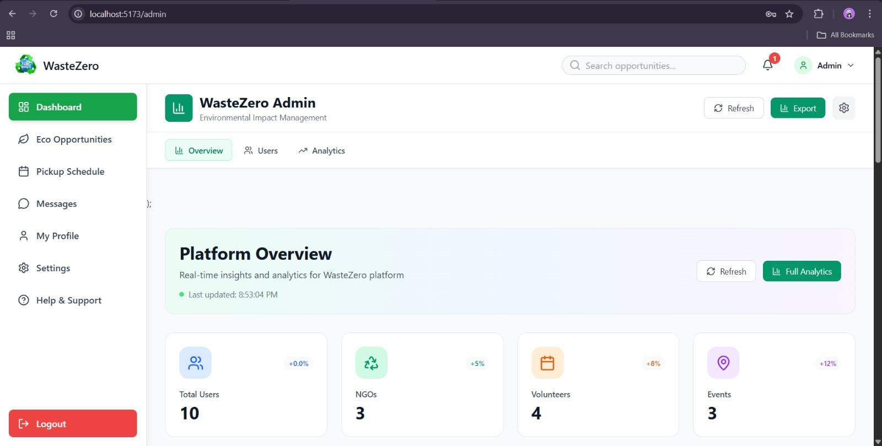
ADMIN DASHBOARD
Data monitoring with visualization
User Management
System Management

Slide 10
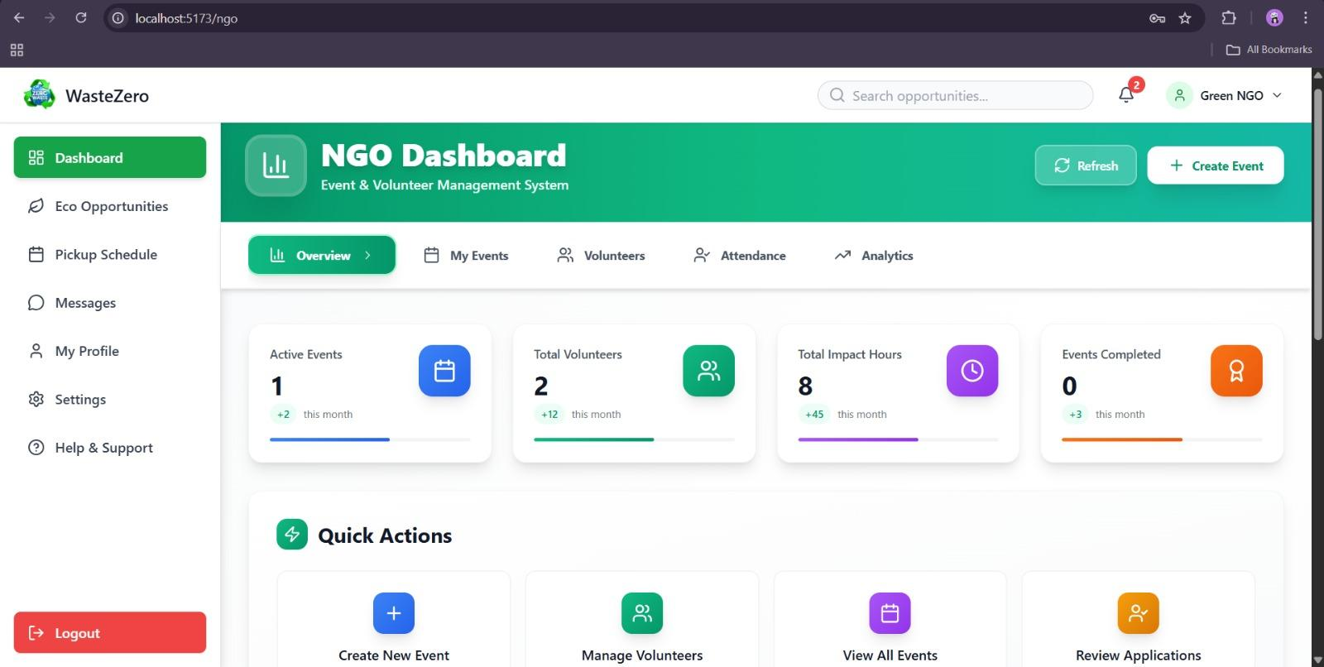
NGO DASHBOARD
Event Management
Volunteer Management
Analytics & Performance Tracking

Slide 11
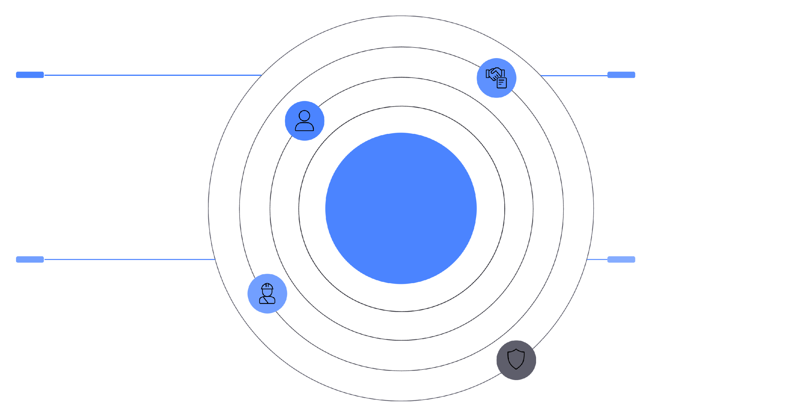
Platform Workflow & User Roles
USER
VOLUNTEER
Apply for events and
track applications
Apply, track, and message
ADMIN & NGO
Platform Workflow & User Roles
NGO
ADMIN
Create/edit/delete events,
approve volunteers
Manage users, block/unblock, oversee platform

Slide 12
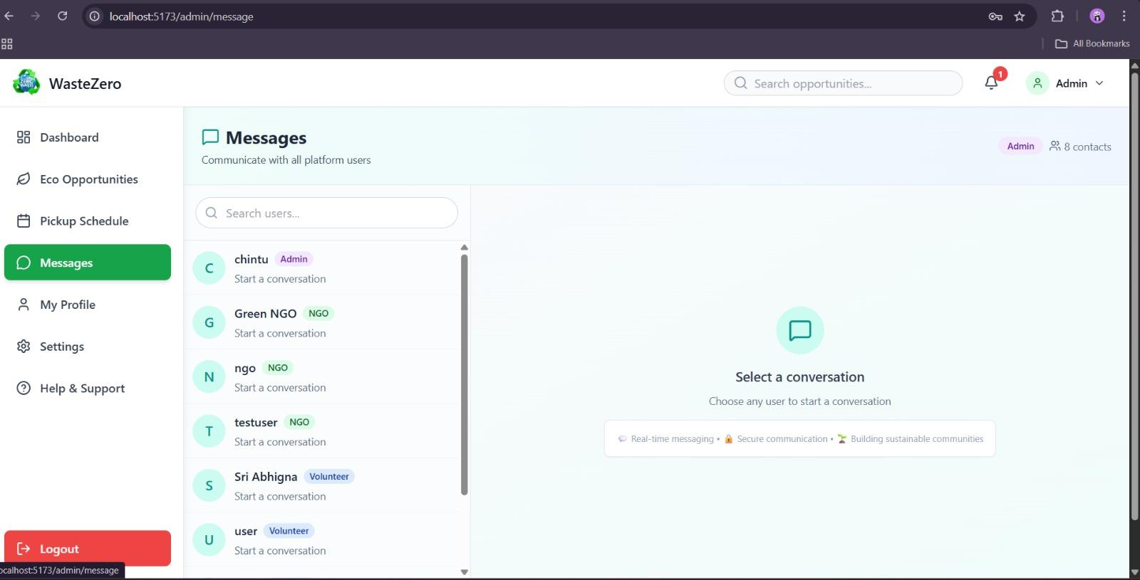
WasteZero Platform Pages Overview
The following cards showcase the various user interfaces and features of the WasteZero platform, including Messaging page, Forget password, Schedule Pickup, Profile and Help and Support Page.

Slide 13
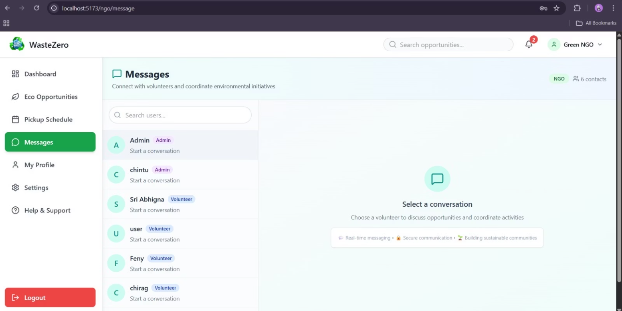
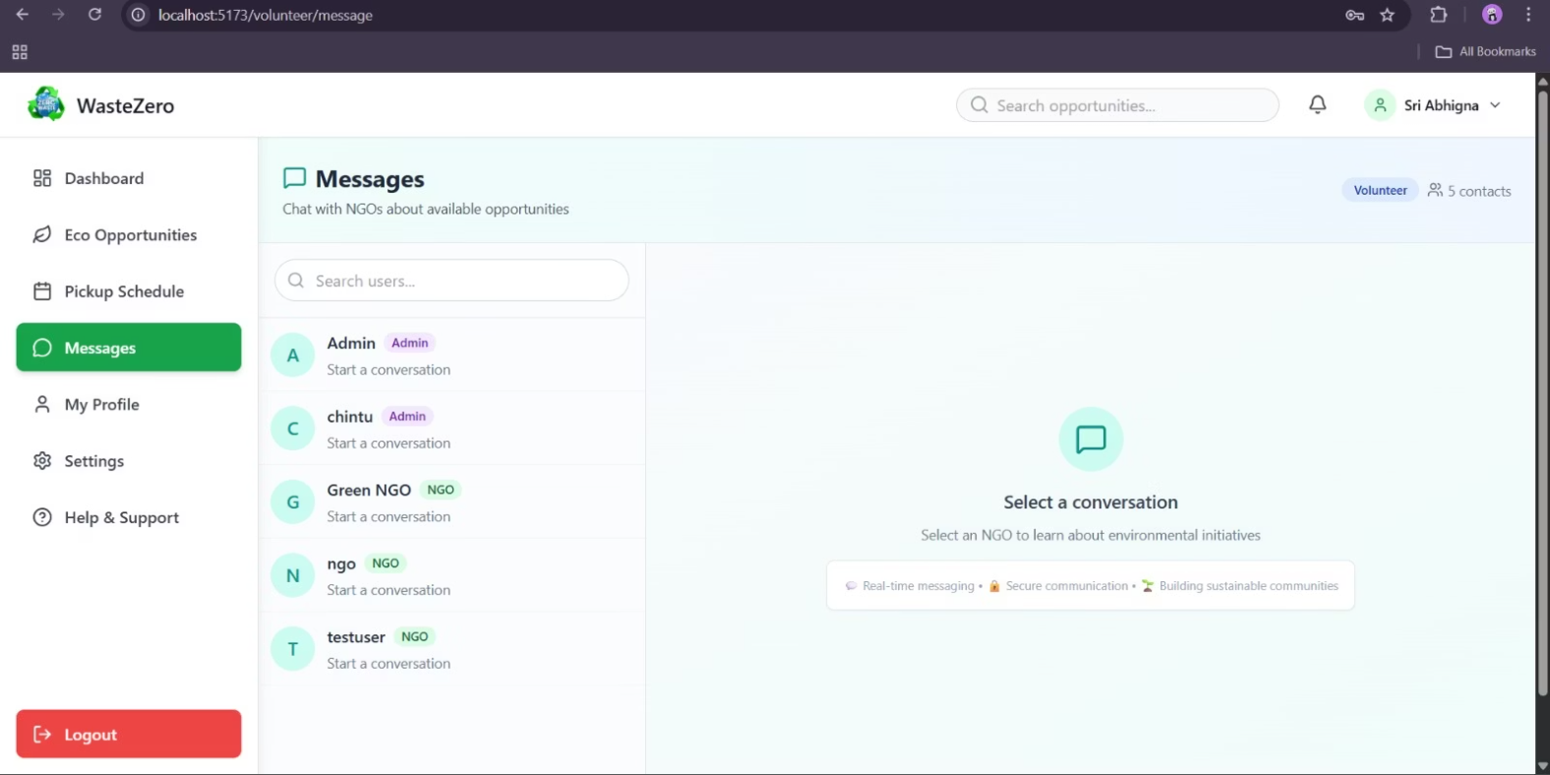
MESSAGING PAGE
Connects volunteers with NGO admins to clarify doubts.
Allows volunteers to chat with NGO admins for quick help.
Enables direct communication between volunteers and admins.
Supports doubt clearance through volunteer-admin messaging.
NGO Side
Volunteer Side

Slide 14
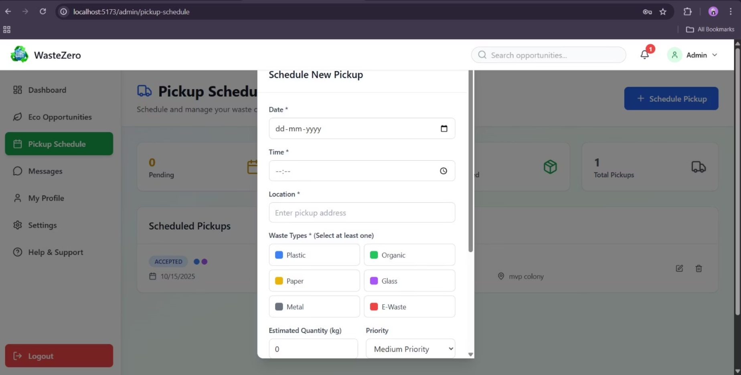
SCHEDULE PICKUP
Book a pickup
Schedule a collection
Request pickup
Pick-up scheduling

Slide 15
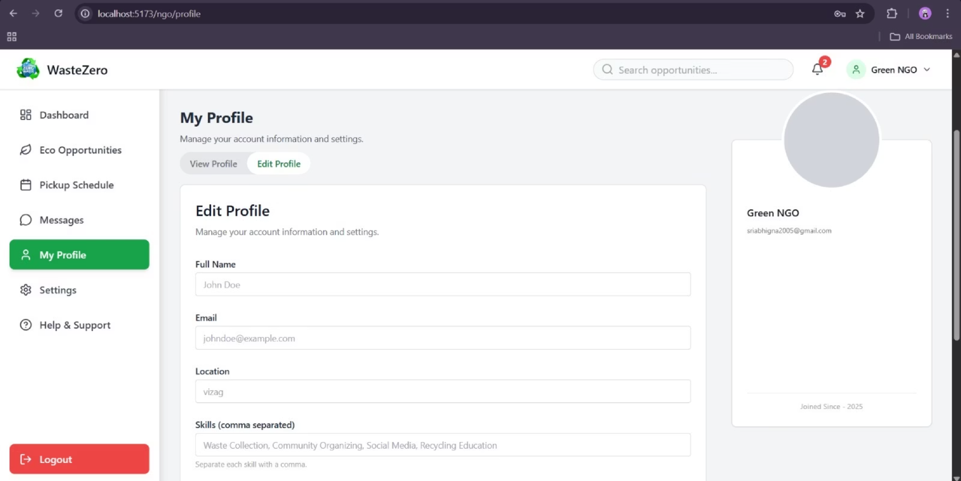
PROFILE PAGE
Here user can update their profile

Slide 16
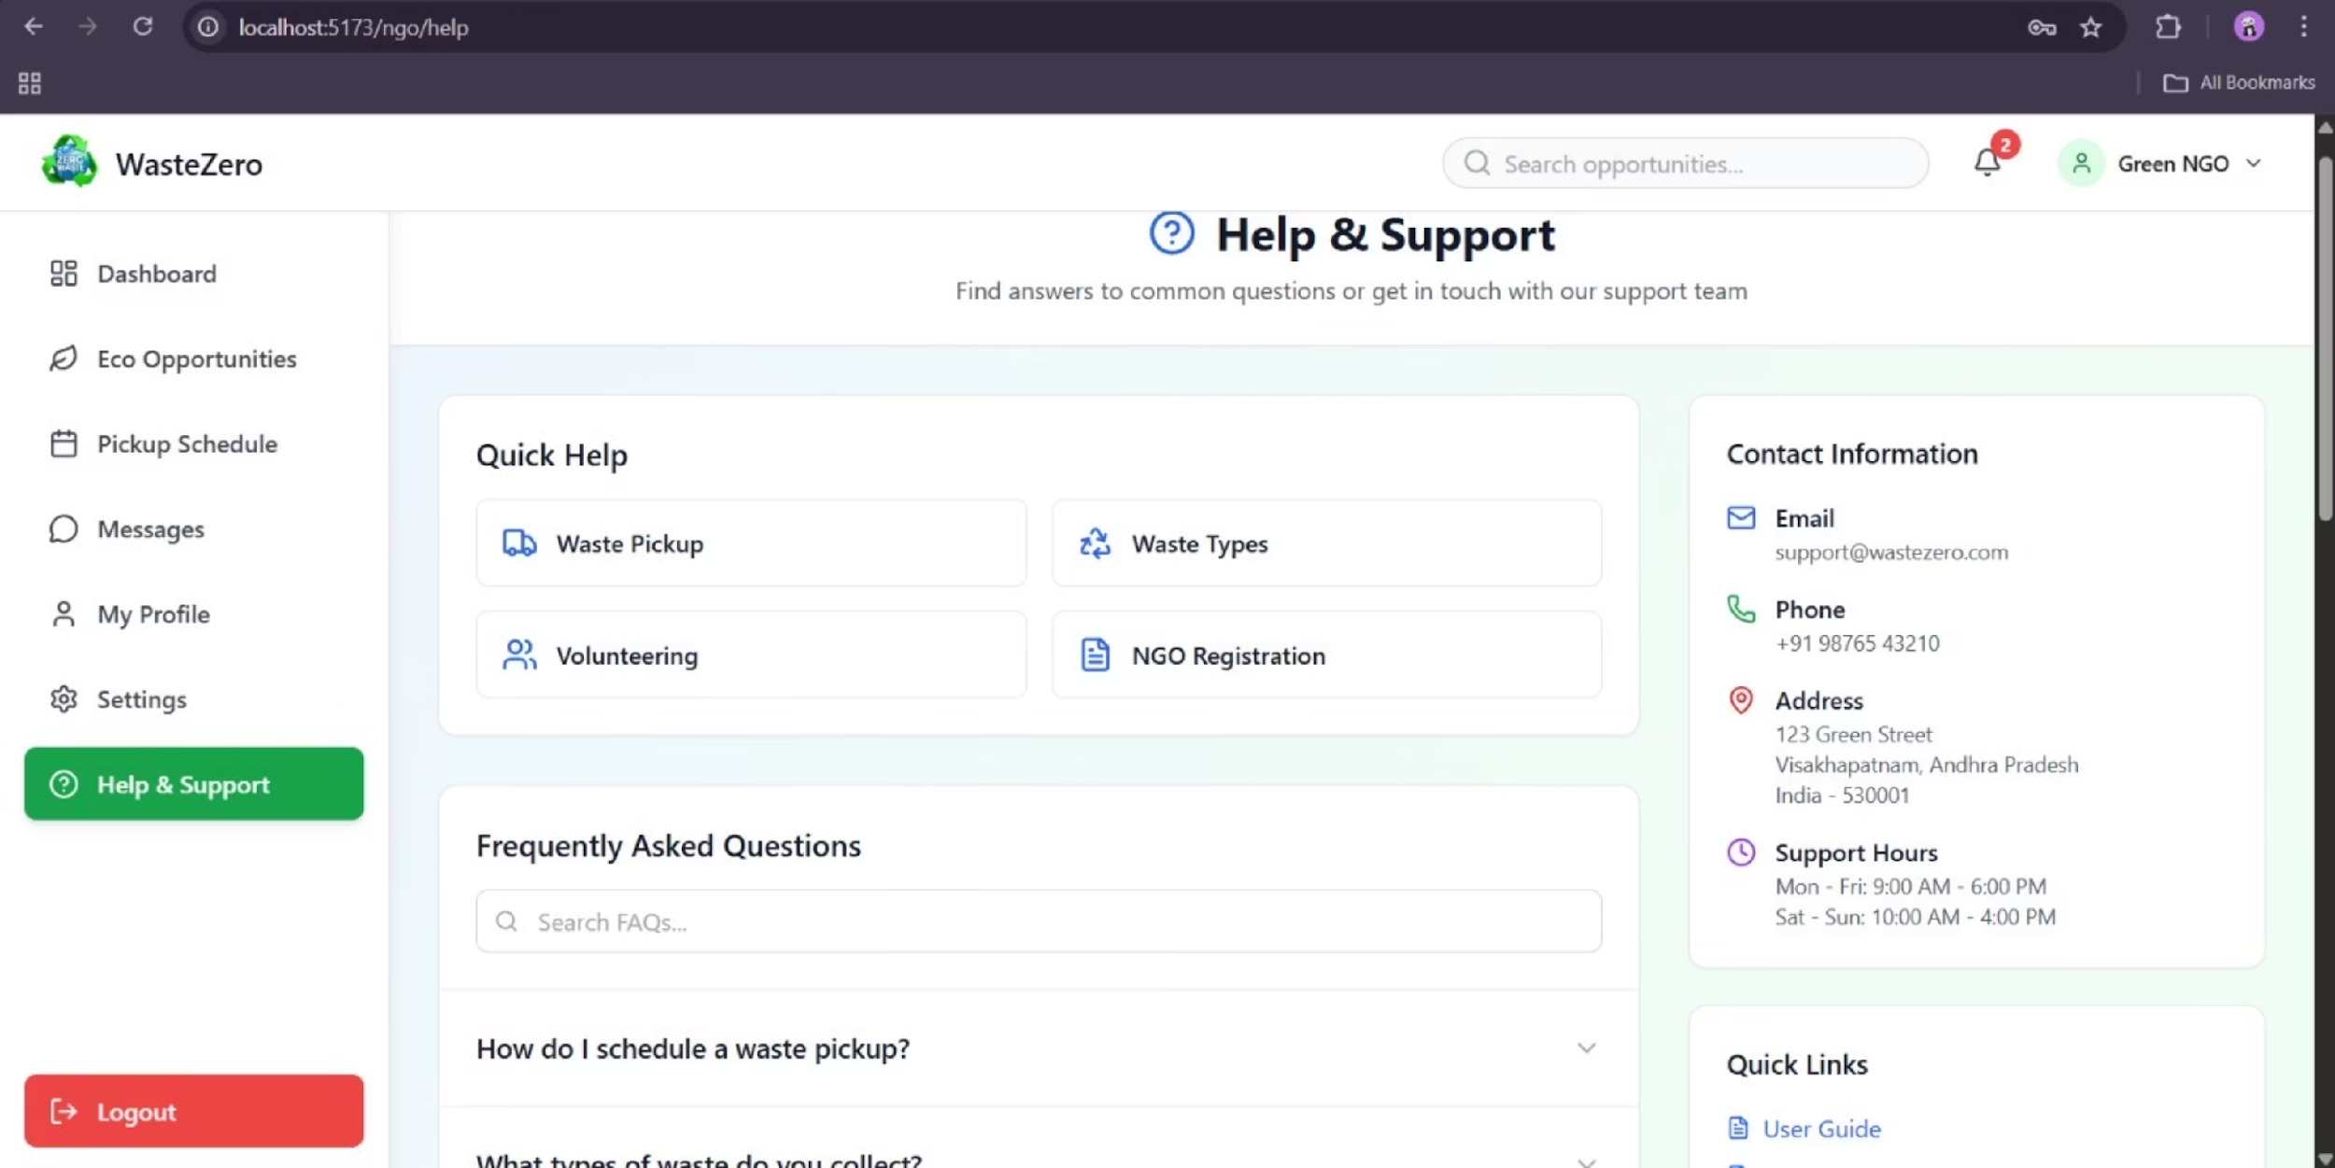
Help and Support Page

Slide 17
FUTURE IMPLEMENTATION
To further enhance the efficiency and reach of WasteZero, several future developments are planned to make the platform more inclusive, intelligent, and community-driven:
Multilingual and Accessibility Support: The platform will be expanded to support multiple languages and accessibility features, ensuring that people from diverse linguistic and physical backgrounds can easily use it.
Reward and Engagement System: A points-based reward system will be introduced to encourage consistent participation. Users and volunteers will earn rewards for responsible waste segregation and regular contributions to community cleanliness drives.
Mobile Application Development: A dedicated mobile app will be launched to provide better accessibility, real-time notifications, and a smoother user experience.
Volunteer Empowerment: Volunteers will gain the ability to organize local collection or awareness events within their own communities, fostering stronger engagement and ownership at the grassroots level.
AI Integration: Artificial Intelligence will be implemented to optimize pickup routes, predict waste generation patterns, and recommend efficient recycling strategies, making the system smarter and more data-driven.

Slide 18
CONCLUSION
WasteZero is a smart, technology-driven platform developed to transform urban waste management by bridging the gap between citizens and waste collection services. The goal
is to make recycling and responsible waste disposal simple, efficient, and accessible to everyone.
The platform is built around four main components:
User Interaction: A clean and intuitive interface allows residents to easily sign up, schedule waste pickups, and correctly categorize their waste—whether its plastic, organic, or electronic.
Smart Operations: Behind the scenes, an intelligent system automatically assigns the nearest available collection partner (such as NGOs or volunteers) based on both location and waste type to maximize efficiency.
Real-Time Communication: The system enables instant updates and notifications, keeping users and pickup agents informed about ongoing requests and their statuses.
Administrative Management: A dedicated admin dashboard ensures seamless monitoring of platform activity, report generation, and content management to maintain smooth operations.
By digitalizing the waste management cycle, WasteZero not only improves recycling efficiency and optimizes collection routes
but also encourages citizens to actively participate in building cleaner, more sustainable communities.

